Slide 1
Taking a Patient History
CTVT: Chapter 7 (pp. 221-226)

Slide 2

Objectives
Understand the role of the veterinary technician in taking a patient history
Know the importance of signalment
Understand ins and outs of “working a room”
Know categories of information needed in a patient history and be able to list common questions
Understand what a leading question is, and how to gain accurate information from a client

Slide 3
The Art of Taking a History
  First step to a diagnostic & therapeutic plan
  Allows rapid assessment of significant problems
  Technician plays a very important role
  Gets easier with practice
Notes:
Serves as the basis for subsequent assessment & intervention

Slide 4
Histories: Routine vs Illness-based
Preventive care visits:
  Changes since last visit
  General history
  PE still important
  Routine activities
Illness-based visits:
  History starts more general, then addresses chief complaint specifically
  PE is essential
  Based on “detective work”
Notes:
Bloodwork, vaccines, heartworm tests, other labwork

Slide 5
Before placing a client in a room…
Gather all supplies
Know:
  Client’s name
  Patient’s name
  Species of animal being examined
  Gender of the animal
  General reason for exam
  How long the client has been waiting (roughly)

Slide 6
“Working Rooms”
Some doctors are better at time management than others.
  Balance of time & personalized care
  Stay aware of wait times
  Put your smile & “patience hat” on
Worried clients aren’t always nice clients
Be sure you have the right room and the DVM knows where to go next
Remember : YOU are the initial face of the practice

Slide 7
“Working Rooms”
Rooms should be clean
  Tables disinfected
  Fur swept up
  Walls are clean
  Waiting clients are judgmental clients!
Clients can almost always hear you outside their room
  Careful when venting
  Perception is reality

Slide 8
In The Exam Room
Greet Client and pet
  Rapport - A relationship of mutual trust and respect
If pet was taken away, reassure client
Introduce yourself and your role
Show a positive interest in the pet
Every client deserves to be treated with respect
  Especially the “problem” clients
Thank the client for providing the care the animal needs

Slide 9
Asking the Right Questions
Watch the use of medical terminology
  Jargon - Technical terminology unique to a particular subject
Use language that doesn’t confuse or insult
Ask open-ended rather than leading questions
  Requires client to fill in information themselves
  May have to ask more than once
Avoid judgment of their care & management
Confirm your understanding
Notes:
Avoid too technical or too infantile
Help them to feel comfortable sharing information

Slide 10
Asking the Right Questions
Clients may be difficult to keep on topic
  May be shy or intimidated
Someone other than the owner may bring pet in
Questions should be unbiased
  “Leading questions” – Predetermined answers
  Clients want to please - May answer “yes” always
Listen for what the owner doesn’t say as well as what is said
Inaccurate information can be worse than obtaining no history at all!

Slide 11
Examples of Questions
Which is preferred?
  “Have you noticed any coughing or sneezing?”
  “What behavior have you seen that is unusual?”
  “Is Ginger eating normally?”
  “How has Ginger been eating?”
  “You’re not feeding her table scraps, are you?”
  “Name all the food that she typically eats.”

Slide 12
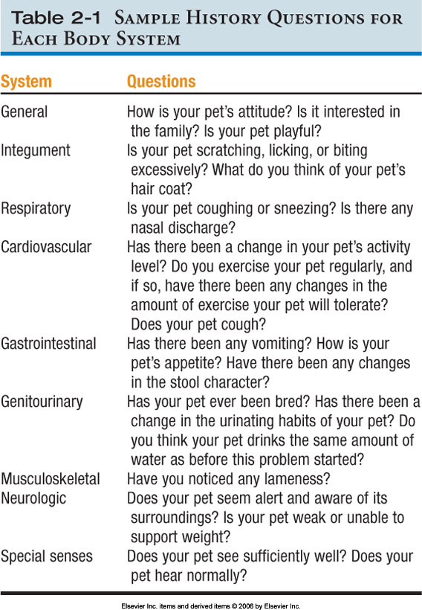

Slide 13
Parts of A History
Signalment
Background information
Medical/surgical history
Presenting complaint
Last normal
Medications
Body systems review

Slide 14
Signalment
Detailed description of characteristics
Includes:
  Age
  Breed (dominant, if mixed)
  Sex
  Reproductive Status
Why is signalment important?

Slide 15
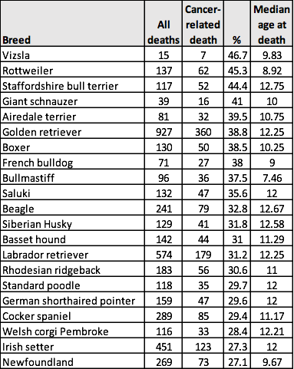
Cancer-related Mortality by Breed
Cancer accounted for 27% of total deaths
Source: Kennel Club/British Small Animal Veterinary Association Scientific Committee. Purebred Dog Health Survey 2004, http://www.thekennelclub.org.uk/item/549

Slide 16
Background Info to Gather
How long owned & where obtained
  Breeder or other source?
Previous medical problems
Recent travel outside area
Where is pet kept?
Normal routine
Dietary history
  Indiscretions?
Notes:
Type of food
Treats?
Amount
Frequency
Recent changes
Dietary Indiscretion

Slide 17
Background Info to Gather
  Preventive care
    Vaccines
    Heartworm & flea prevention
      Timeliness?
  Behavioral information
    Normal or changes related to illness
      Aggression, disorientation, unusual elimination, etc.
    Can alert you to cautions towards staff

Slide 18
Background Info to Gather
  Household/environmental information
    Health of other animals
    Exposure to animals outside household
    Exposure to toxins, human medications
  Allergy history/adverse reactions
    Prior blood transfusion reactions
  Reproductive history
    Age at spay/neuter
    Current or previous breeding
    Timing of most recent heat cycle
Notes:
Type of environment may narrow list of potential causes
Outdoor or indoor?
Multiple animals?
Rural or urban?
Exposure to known toxins?

Slide 19
Sago Palm Toxicity
Contains Cycasin
  Hepatotoxic (dogs)
50-75% mortality

Slide 20
Patient Medical/Surgical History
Medical:
  Recurrent bouts of similar problems
  Previous health problems
Surgical:
  Past surgeries?
  Complications experienced?
Trauma:
  Accidents in the past
    Owner habits
Notes:
Can provide valuable information related to current problem.
Determine any other medical problems than chief complaint
Answers may alter list of differential diagnoses.

Slide 21
Presenting/Chief Complaint
Why are they here?
Time is of the essence, if life-threatening
Most important part of the history-taking process
There may be more than one problem

Slide 22
Last Normal?
Obtain detailed information about the chief complaint…
  Duration/Timeline
  Severity
  Progression
    Helps in prioritizing problems
    Better/worse/the same
    Rapid worsening may mean aggressive therapy needed
  Frequency/time of day
  Triggers
  Character of the problem

Slide 23
Example
A 3 year old intact male Rottweiler presents with watery diarrhea and has been vomiting mucous and bile. Problem has been going on for 5 days with at least one instance daily. Patient seems to be declining, and no longer seems interested in food.
Signalment?
Duration?
Severity?
Progression?
Character?

Slide 24
Medications History
Information needed:
  Medicine name
  Dose/frequency
  Duration
  Reason
  Has it helped?
People & animal meds
  Include supplements
  Can include off-label meds
Potential for:
  Side effects
  Drug interactions

Slide 25
Body Systems & Exposure
Ask about each body system
Know common ailments for geographic area and practice
  Lyme & Lepto prevalence
  Snakebites & heat stroke
Record all answers and information
All clients should be asked about:
  Coughing, sneezing, vomiting, diarrhea, polyuria, polydipsia
Notes:
Lyme disease is caused by the bacterium Borrelia burgdorferi and is transmitted to humans through the bite of infected blacklegged ticks
Leptospirosis is one of the most common, widespread, and underdiagnosed infections transmitted from animals to humans, with the principal source of human infection being the rat.
Leptospirosis is acquired through direct or indirect contact with the urine of an infected animal. The spirochete most commonly enters through abrasions in the skin or through the conjunctiva

Slide 26
Prevalence
Lyme Disease
Cause: Bacteria from black-legged ticks
Leptospirosis
Cause: Spirochete from infected urine

Slide 27
Heartworm Incidence
2010
2014

Slide 28
Document Carefully
Write carefully, neatly, and accurately
Use medical terminology
Provides legal documentation
Can be paper-based or automated
In clinics, blue or black ink only
Standardized history forms are helpful
Prompts to gather needed information

