Slide 1
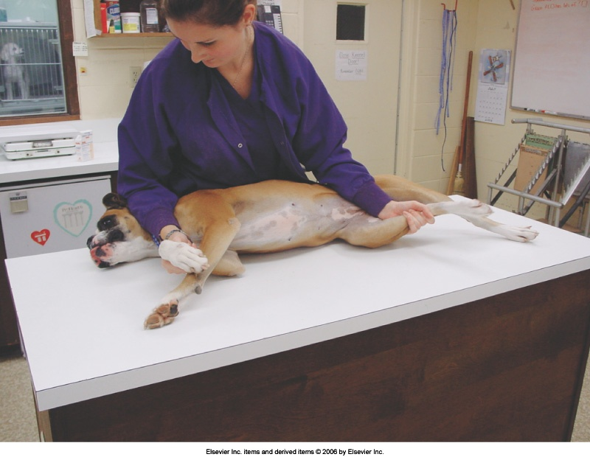
Restraining in Lateral Recumbency
Right recumbency = right side down
Use your body…but not too much
Procedure:
  Reach over animal to grasp legs closest to your body
  Gently pull animal onto their side (no body slams!)
  Keep hold of legs closest to the table
  “Hold off” as needed - Occlude vein

Slide 2
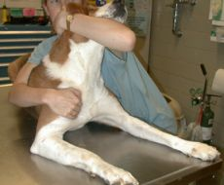
Restraint in Sternal Recumbency
Procedure:
Ease dog down onto belly
Reach around to hold onto chest & legs
  This hand can let go to “hold off” cephalic vein
Place other arm around neck to secure head
Hold off vein as needed
“It’s all in the holder”

Slide 3
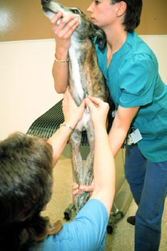
Restraint for Jugular Venipuncture
Technique can vary
Restrainer keeps body still by holding front legs or positioning against wall
Restrainer lifts head up slightly and away from the jugular that will be drawn from
Venipuncturist “holds off”
Notes:
Notes:
Watch position of head
Don’t let head move
Don’t get in the way of the venipuncturist
Don’t be jumpy

Slide 4
General Restraint Tips
Document issues for future visits
Don’t rush
Know when to take a break
Check gums & tongue periodically
Communicate with colleagues
Get help when necessary
Stay away from the business end

Slide 5
Types of Aggression: Canine
Irritability or Pain-induced - Vaccines or procedures
Maternal – Possession or protection
Predatory – Chasing/killing prey (food or fun)
Territorial - Home, crate, owner
Fear-Induced - Environment or situation
  “Fear biters”
Inter-male - Competition
Dominance – Pack hierarchy

Slide 6
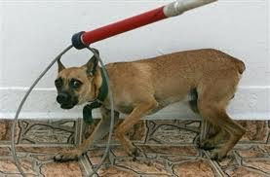
Rabies or “Catch” Pole
Used only in extreme aggression cases
Maintains a safe distance

Slide 7
Restraining Fractious Dogs: Muzzles
Safe & effective
First choice for restraint
Owners accept them (& sometimes bring them)
Not a value judgment
Snug but not too snug
Notes:
Beware if they bring their own muzzle

Slide 8
Fractious Dogs: Gauze Muzzle
Used when animal cannot be muzzled any other way
  Limits panting & observation of tongue color
Must be tied tightly to be effective
Procedure: (Remember, animal is very fractious!)
  Tie a loose loop in a length of stretch gauze
  Bring loop around animal’s muzzle & tighten
  Bring ends down below mandible and tie once
  Bring ends behind head & secure
  Remove once nylon muzzle is placed

Slide 9
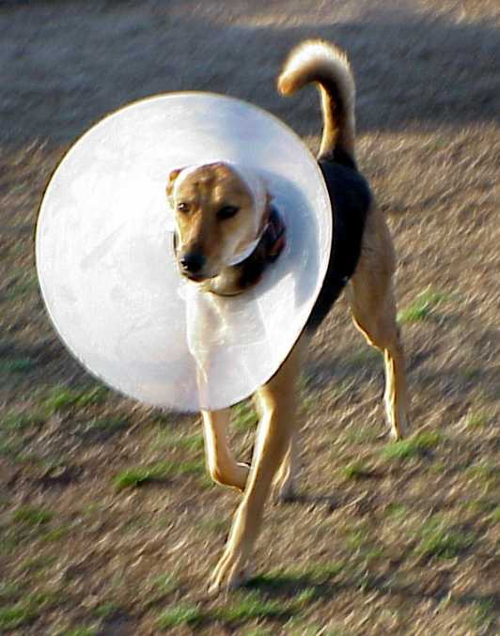
Fractious Dogs: Towel Restraint
Elizabethan Collars
“E-collars”
Used for temporary restraint or to medicate animal
Use fairly thick towel so dog can’t bite through
Roll towel lengthwise & wrap around neck
  Thickness hinders head movement
  Make sure towel isn’t too tight

Slide 10
Fractious Dogs: Chemical Restraint
Medical sedation
Can alleviate anxiety
Used as a last resort or if pain management is required
  Can have health consequences
  Sedatives hinder physical assessment
Sedated animals are still capable of biting!!
Notes:
Mental state, physical parameters
Dogs can become so excited they override effects

Slide 11
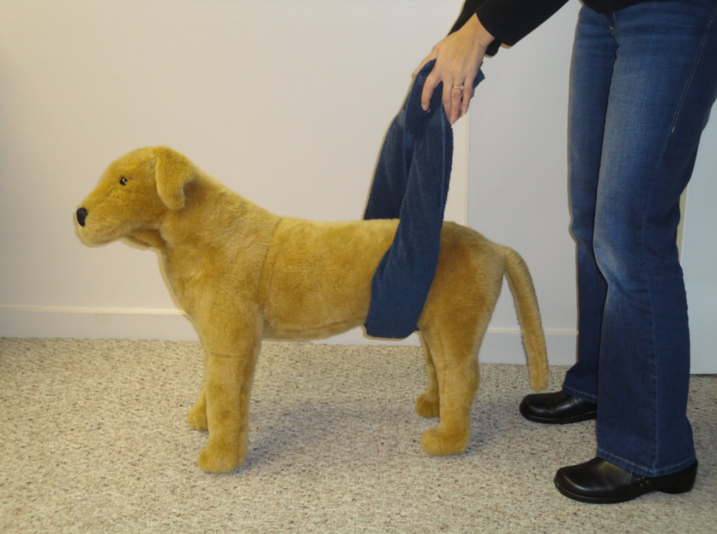
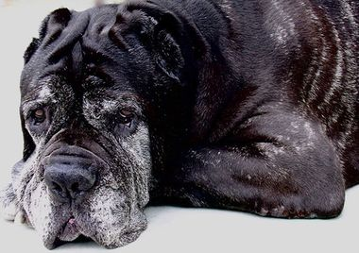
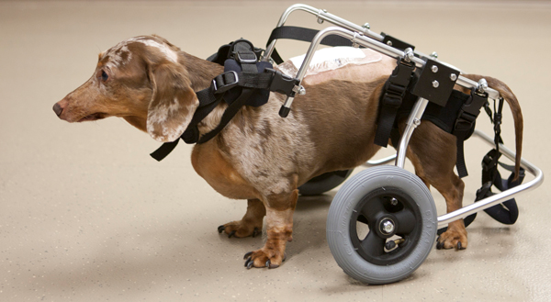
Special Cases
Be patient with me while I heal…
Be gentle with me. I’m old…
https://www.youtube.com/watch?v=t3q118uhKJM&spfreload=10
Rehabilitation

