Slide 1
Canine Restraint & Handling
CTVT pp. 176-190

Slide 2
Objectives
Understand indications for canine restraint
Describe strategies for approaching dogs before contact
Recognize aggressive body language in a canine
Understand how to reduce patient stress prior to and during handling
Understand equipment & methods for initiating contact and restraining both cooperative & uncooperative dogs
Understand advantages & disadvantages of chemical restraint for animal control
Describe various positions for restraining dogs for venipuncture and nail trims

Slide 3
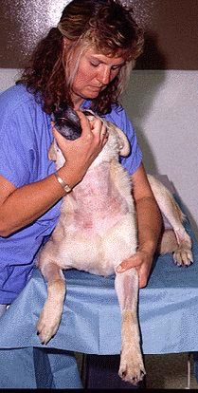
Why restrain?
Control for medical care
Prevent the animal from harming itself
  “Fleeing behavior”
Protect personnel
Liability starts as soon as the owner enters the parking lot
Notes:
Fleeing:
Jumping off table
Crashing through fence
Chewing bars – stuck on bars,

Slide 4
Approaching a Dog
Observe first
  Wagging tail may not mean happy
Watch for:
  Warnings – vocalization, growling
  Displacement behaviors - Coping behaviors intended to reduce animal stress
Notes:
Yawning, scratching, licking lips

Slide 5
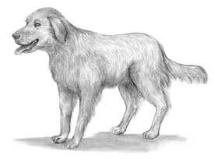
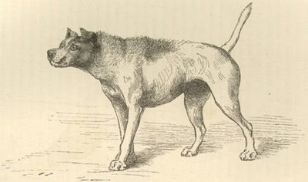
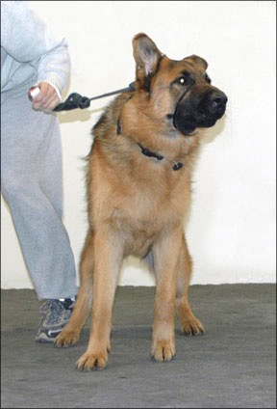
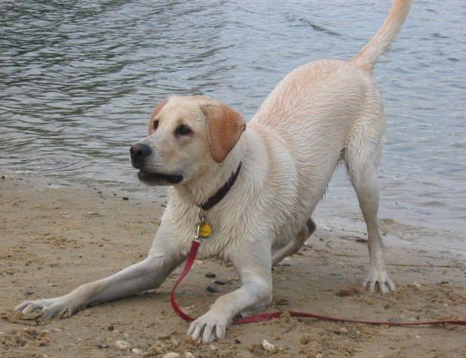
Observing the Dog

Slide 6
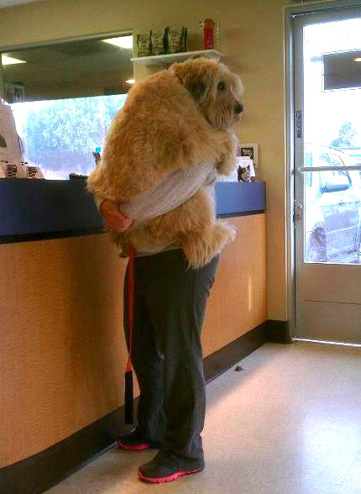
Initiating Contact
May be protective of owner
  Use caution when taking a small dog from owner’s arms
Remain non-threatening
  Let the dog come to you
  Palm down - allow to smell
  Indirect gaze
  Approach at an angle
  Slow hand movements
  Pleasant, easy tone
  Don’t lean over or corner
Careful of retractable leashes
Notes:
White coat fever
Scents – anal glands, urine, feces
Wash hands & clean room

Slide 7
Fight or Flight
…or “freeze”
Physiology
  Stimulation of sympathetic nervous system (SNS)
  Increased HR & blood pressure
  Increased blood flow to muscles, lungs, and brain
  Can escalate to aggression
Animal will usually prefer to get away

Slide 8
Owner Perception & Behavior
Pet owners expect respect & compassion
Wrestling with a pet or using “excessive” force can damage a client’s perceptions of practice
Too stressful for the pet = owner may forego future visits
Show you “like” their pet
Notes:
Techs as customers

Slide 9
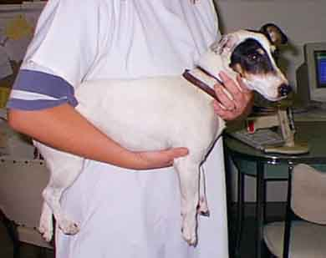
Picking up a Small or Medium Dog
“Greet” dog first
Reach around back and under front legs
  Place 1-2 fingers between front legs
Other hand wraps around head to maintain control
Hold animal close
If fractious, take from owner tail first
“Controlling the mandible controls the head”

Slide 10
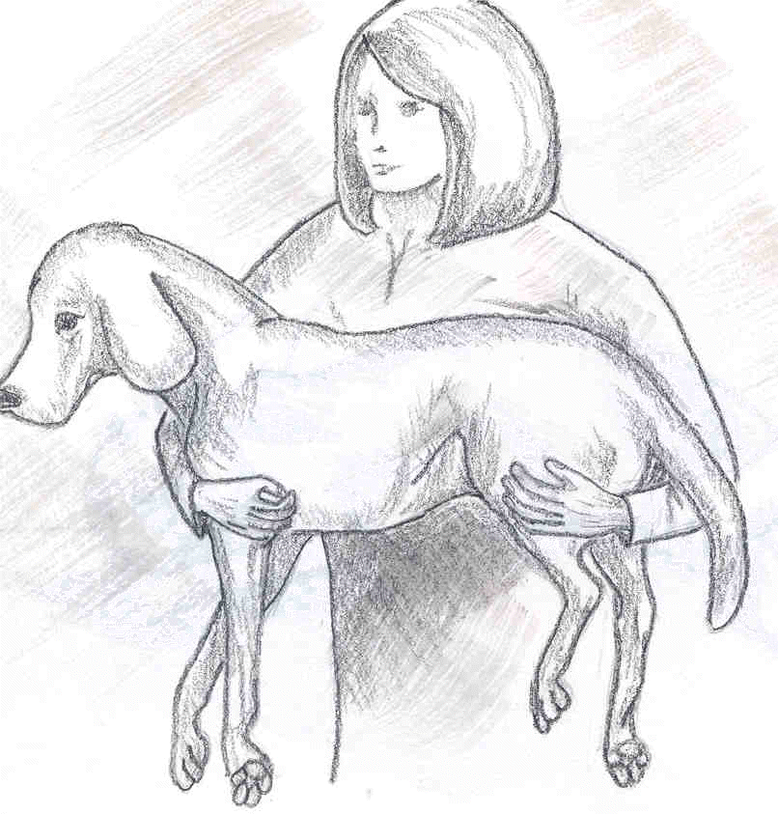
Lamb Hold
For carrying medium-sized dogs short distances
One hand surrounds and holds front legs while other hand holds back legs
Not used for fractious animals…

Slide 11
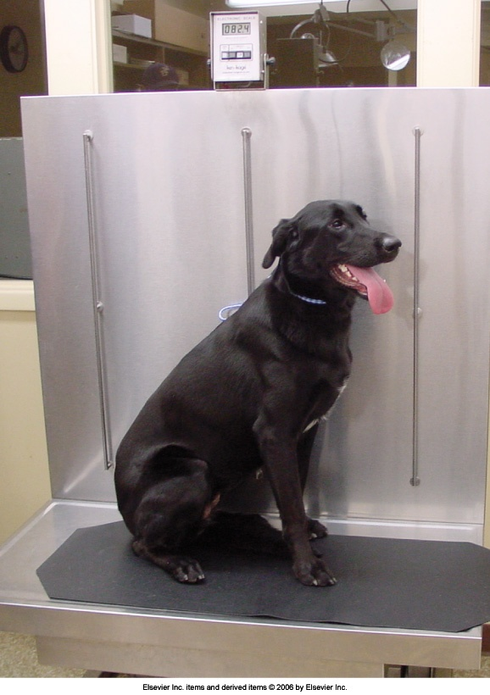
The Lift Table
Self-contained scale
Cleans easily
    Leash secures to vertical wall
Lifts the dog for you
Gurney transfer works well

Slide 12
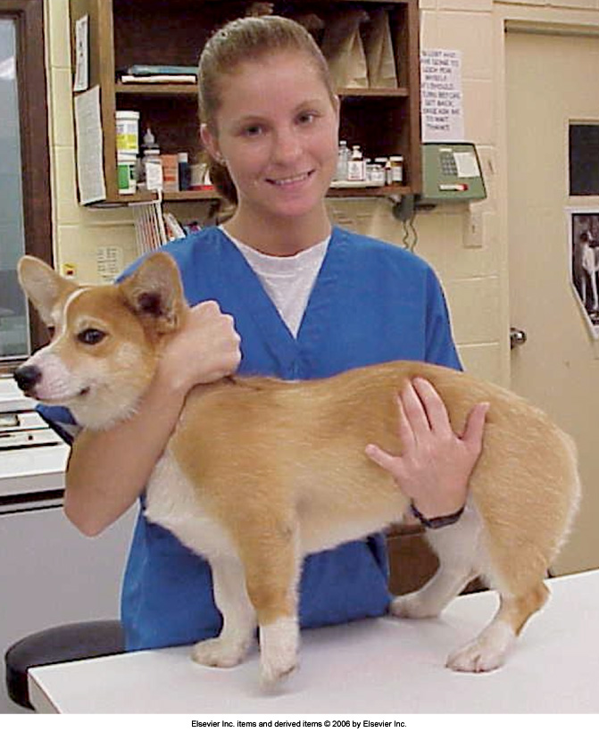
Forklift Hold
The most common restraint for dogs
Can be done on the floor or table
Procedure:
  One arm is placed under the abdomen in front of back legs
  The other arm goes under animal’s neck with the hand holding snugly behind ears (elbow under throat)
  Hold animal close to the body
Cautions:
  Hold dog closer if he/she tenses
  Be careful not to occlude trachea
  Don’t let go!

Slide 13
When Restraining…
“Less is more.”
“Never trust a terrier”
D.A.P. - Dog-appeasing pheromone spray
    Pheromone - Chemical secreted by the body that can change behavior
Place large dogs on table, if possible
Owner should not restrain their own dog

