Slide 1

Staying Safe:
Animal-Related Injuries & Disease

Slide 2
Husbandry – The Real Story
Our kennels
Cleanliness = health
Compassion & comfort
No one particularly likes it
  Everyone’s job!
A place to shine

Slide 3
The Risk of Injury in a Veterinary Practice
About 200 people in the US die each year from accidents or injuries caused by animals
  15-20 are generally caused by dog attacks
  2013: 31 media-reported dog-bite fatalities
    25 were Pit Bulls or Pit mixes
Severity & injury type depends on species:
  Dogs defend with their teeth, so bite wounds are the biggest risk.
  Cats scratch & bite

Slide 4
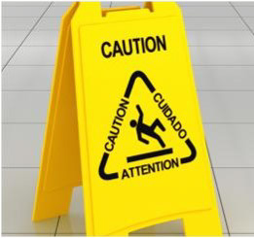
Types of Kennel-Related Injuries
Bumps & bruises
  Leashes, kennel doors, falls
Bites & scratches
Zoonosis

Slide 5
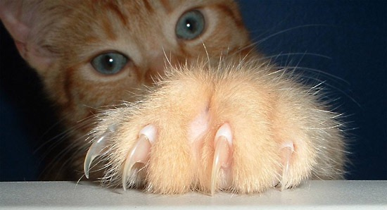
Bites & Scratches
Dogs inflict 80-90% of all animal bites to the general public each year.
  Usually the forearm
  Usually involves tissue trauma
Cat bites are responsible for more serious injury to hospital staff.
  Usually the hand
  Higher risk of infection
      30-50% for cats vs 2-5% for dogs

Slide 6
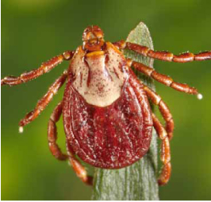
Zoonotic Illness
Zoonosis: An infectious disease transmitted between species
Over 150 known zoonotic diseases
Primary routes of transmission:
  Oral - Most common, usually feces
  Skin - Usually parasitic diseases
  Mucus membranes - Infective droplets
  Wounds - Bites, scratches, broken skin
  Inhalation - Bacteria or fungi
  Insects - Transmitted via vectors or hosts

Slide 7
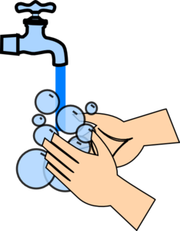
Preventing Zoonotic Transmission
Practice good hospital hygiene
  Hand washing
  Avoid hand-to-mouth contact
  When in doubt, glove up!
Recognize susceptibility to disease
  Vaccinations
  Immunocompromised
  Very young & old
Notes:
No kissing the animals!!
10-second wash
After labs, husbandry, between animals
When leaving building
Personal protective equipment (PPE)
Foot baths & other precautions

Slide 8
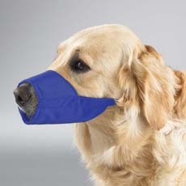
Reducing the Overall Risk of Injury
Safe restraint & cage removal
Get help when lifting, treating, and restraining
Use restraint equipment with fractious animals
  Towel, bags, muzzles, catch pole
Watch the animal, not the procedure.
  Animals can move quickly
Notes:
Bags, muzzles, leather gloves

Slide 9
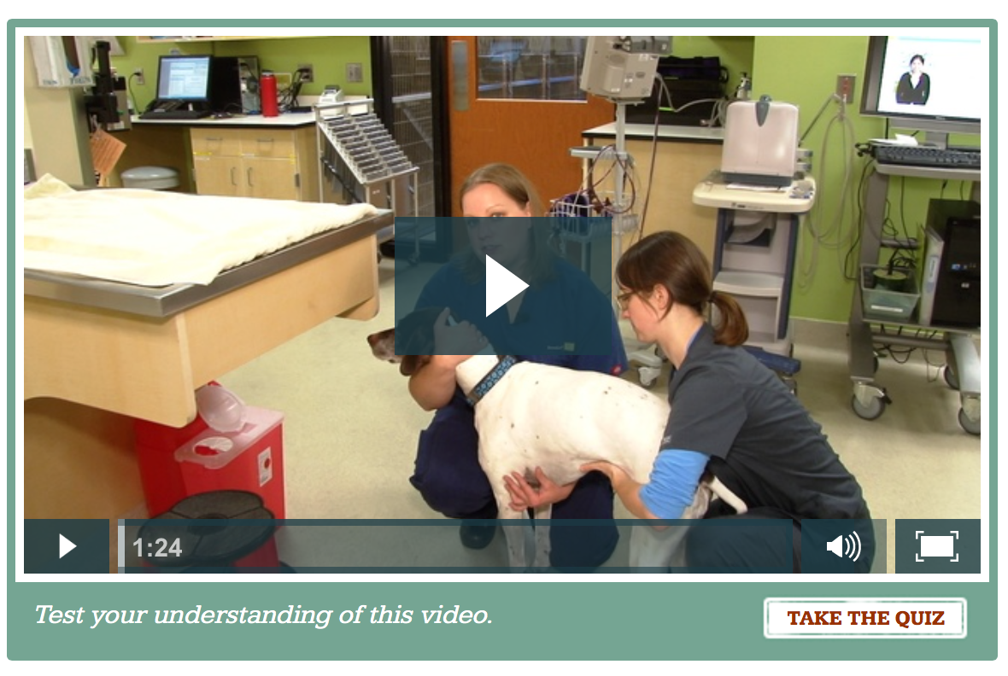
Video: Safe Lifting
https://www.atdove.org/videos/Procedure/Safe-Lifting

Slide 10
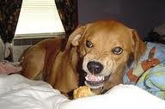
Reducing the Overall Risk of Injury
Use chemical restraint, if warranted
Avoid working with a fractious animal alone
Use caution if an animal may feel threatened or cornered
  Label kennels if aggressive
Plan in advance for an exit route if attacked

