Slide 1

Being Successful at VTI
Welcome!!

Slide 2
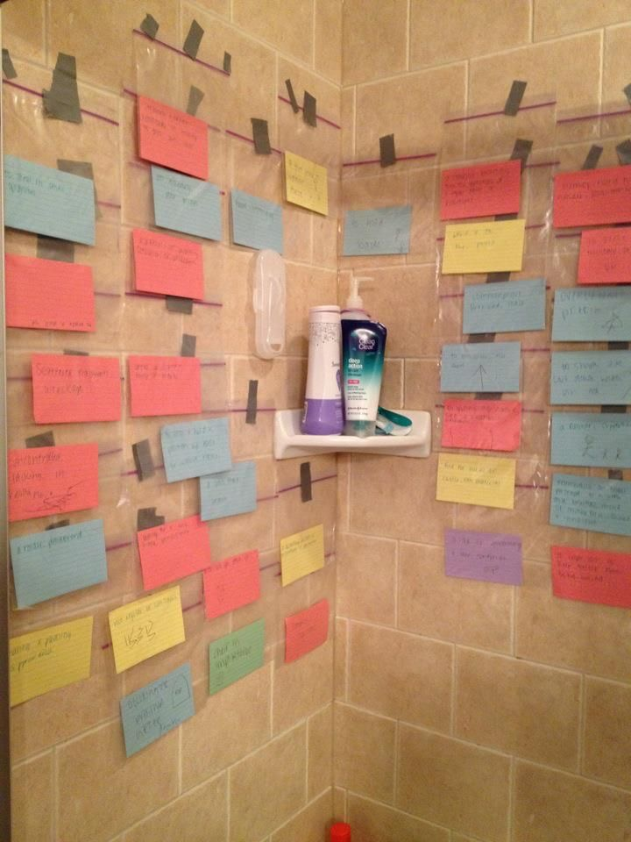
You Can Do This!!

Slide 3
Objectives: Aiming For Success at VTI
Understand the benefits & challenges of an accelerated study program
Learn to emulate habits of successful students
Learn to avoid habits of unsuccessful students
Discuss tools for success in school
Understand Bloom’s Taxonomy and its role in critical thinking
Brainstorm study strategies that work for you

Slide 4

Accelerated...? What gives?
You graduate “early” but…
  8 vs 16 week classes
    Living with change
  Lots of work
  Every weekday
  Long days can mean
    Stress at school – yours, classmates
    Stress at home
Notes:
Labs, classroom, homework
Stress across cohort
Constant changes in staff, expectations, starting over
Cost vs benefits of work outside school
Takes full dedication

Slide 5

Successful Students at VTI…
Know that EVERY grade counts
    Attendance
    Husbandry
    Professionalism
    Every point
Over-deliver!

Slide 6

Successful Students at VTI…
Over-deliver!

Slide 7
Successful Students at VTI…
Help each other - BOTD
Follow the rules
Stay positive
Are involved – VTSO, etc.
Take responsibility for their learning
    Ask questions
Notes:
Instructors will be asked to support externship decisions
Consider tape recording

Slide 8
Successful Students at VTI…
Communicate with instructors
    Ask for help
    Utilize advisement & tutoring
Prioritize school before fun
Plan their work & work their plan
Notes:
No blowing off grades
Plan your work and work your plan. Schedule time for homework and stick to your schedule unless a real emergency gets in the way. If you need a break after school, take it and schedule homework time later in the evening. Remembering that the opposite of stress is relaxation, just be sure to schedule both.
Special tip: Don't let work build up to clutter up your weekend. Although you may choose to work on all or part of a Saturday or Sunday, do make one of them your "day off." You'll find that facing the coming week is much easier when you've had real time to refresh.

Slide 9
Unsuccessful Students at VTI…
Blame others
Rely on osmosis
Stop trying
Feel entitled to an easier ride
Do things halfway
Let the world distract – phones, etc.

Slide 10
What study strategies have helped you achieve success in school?

Slide 11
Use your tools: Flashcards
Quizlet - http://quizlet.com/29693667/vti-veterinary-terminology-suffixes-flash-cards/
Quizlet Apps:
  A+Pro (iPhone)
  Quizlet for Android

Slide 12
Use your tools: Podcasts
AP Biology
Biology 2110-2120: A&P
Veterinary Clinical Podcast
  Illnesses & care tips
Anatomy & Physiology
ICU Rounds
Veterinary ECC Small Talk
ToxTalk
Also, re-listening to lectures…

Slide 13
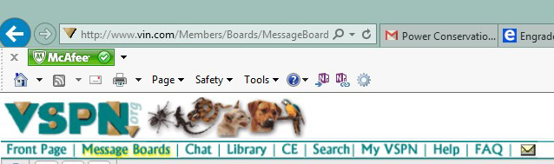
Use your tools: The Web
Idexx.com
Veterinary Support Personnel Network (VSPN) - http://www.vspn.org/
Also… ZukuReview :)
Notes:
VSPN - Students

Slide 14

Reducing Test Stress…
Find out as much as you can about the exam.
  Look for “hints”
Study for the type of test.
Get organized the night before.
Eat before the exam.
Dress for success.
Be on time.
Notes:
Take advantage of any practice tests.
Multiple choice exams usually are fact, formula, and data infused. Essay tests usually require you to have a handle on the subject and possibly go into detail on a topic or two.

Slide 15
About Tests at VTI…
Many instructors let you mark on them
  Use whatever works for you
Most involve scantrons – Always have a pencil!
Ask questions on anything you don’t understand
  The worst that will happen is we can’t answer your question
  Best case is you helped us see that a question was confusing or has more than one answer
You won’t get the test back…
Always review your test afterwards

Slide 16
The Type of Question Matters…
True/False:
  Take it literally – no tricks
    Read the question!
  If any part is false, the question is false
    But partly true doesn’t make statement true
  Read carefully for qualifiers & keywords
    “Never, always, and every”

Slide 17
The Type of Question Matters…
Essay/Short Answer:
  Usually require a deeper knowledge
  Make sure you understand what the question is asking you. If not, ask.
  Answer everything asked of you
  Neatness counts

Slide 18
The Type of Question Matters…
Multiple Choice:
  Facts, formulas, data
  Read the question before you look at the answers
  Come up with the answer before you look at the choices
  “Slash the trash”
  Read all choices carefully before picking your answer
  Your first choice is usually the right one.
Notes:
Teacher hints as to what is important

Slide 19
The Type of Question Matters…
Slide ID/Practicals:
  Relax. You’ve got this.
  Find out all you can before the test.
    New pictures?
  Make sure you understand the format
    Sequential questions or free roaming?
  You have plenty of time. Focus.
Notes:
Teacher hints as to what is important

Slide 20
A Framework for Critical Thinking:
Bloom’s Taxonomy
Systematic classification for thinking & learning
A “stairway” to higher levels of thought
Each level builds on the next
Most questions on the VTNE deal with higher critical thinking
  Instructors use Bloom’s to train you to think that way
All instructors use this framework for teaching & testing
  Many will label the questions with the level

Slide 22
Putting Bloom’s to Use:
Performing a Nail Trim
What nail trim solution do you recommend as safest?
What changes could be made to current nail trim procedures/equipment that might result in a safer trim?
Compare & contrast the various choices in nail clippers.
Why is it important to avoid cutting the quick?
List the steps involved in trimming nails.
What’s the vein in the nail called?

Slide 23

What’s Your Learning Style?
Are you…
Visual?
Auditory?
Kinesthetic/tactile?

Slide 24
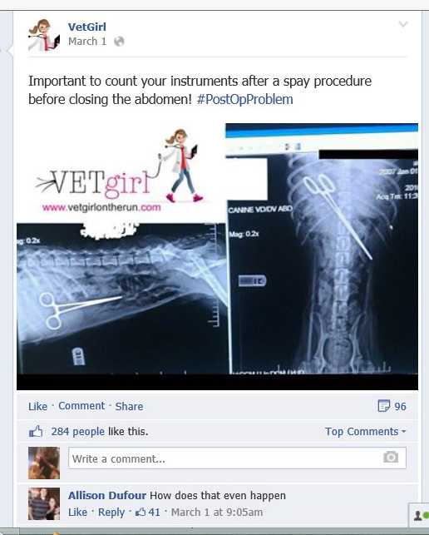
Use your tools: Facebook
Vetgirl - https://www.facebook.com/VetGirlOnTheRun
Wildlife Vet Adventures (South Africa)
American College of Veterinary Radiology
AsapSCIENCE
IFL Science
Notes:
General science sites

