Slide 1
Introduction to Veterinary Technology
CTVT, pp. 1-17

Slide 2
Learning Objectives
Understand the history of Veterinary Technology as a profession
Know the different types of veterinary practices that employ technicians
Describe educational & credentialing requirements for entry into veterinary technology
Explain the structure, format, and scheduling of the VTNE
Describe areas of responsibility for veterinary technicians in clinical practice

Slide 3
I solemnly dedicate myself to aiding animals and society by providing excellent care and services for animals, by alleviating animal suffering, and by promoting public health.
I accept my obligations to practice my profession conscientiously and with sensitivity, adhering to the profession’s Code of Ethics and furthering my knowledge and competence through a commitment to lifelong learning.
- Veterinary Technician Oath

Slide 4
Why would anybody want to be a Veterinary Technician?

Slide 5
Being a Veterinary Technician
An essential part of the health care team
“Eyes & ears”
Gathers clinical information
Analyzes data
Generates a nursing plan
Carries out DVM orders
Unable to prognose, diagnose, attest to health, prescribe medications, or perform surgery
More expectations than human nursing
Radiologist, lab technician, anesthetist, scrub nurse, etc.
Notes:
Documentation & alerts
May not always be treated well but you matter
Thousand yard stare
Only tech in the EC at night
Saving lives –
Drs trust
Building instincts

Slide 6
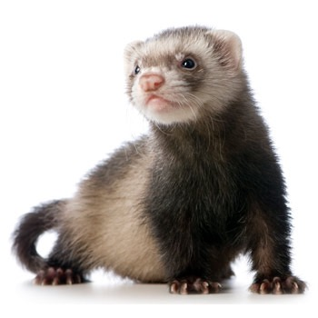
Being a Veterinary Technician
Works with a variety of species
Mirrors human medicine
Treatments, imaging, technology
Uses critical thinking every day
More exposure than ever before – TV, etc.
Notes:
Leveraging to an LVT makes good business sense

Slide 7
History of Veterinary Technology
Early 1960’s: 1st formal university program
“Father of Veterinary Technology” – Walter E. Collins, DVM
1989: Veterinary Technician title created
Previous: Animal Health Technician
Current AVMA-Accredited program stats:
Total Number of Programs: 221
Number offering 4yr degree: 22
Number offering distance learning: 9
Notes:
No accredited programs: Alaska, District of Columbia, Montana
Dr. Collins – Developed a model curriculum plan for training animal health technicians
Led various programs

Slide 8
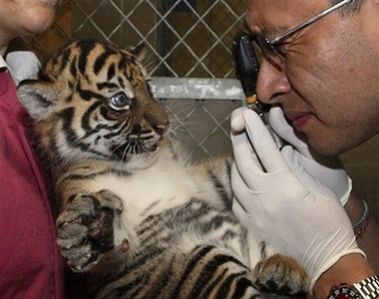
Working as an LVT
Private practice
Companion animal, large animal, mixed
Specialty, referral, day
Zoos & Aquariums
Wildlife rehabilitation
Research
Sales
Entrepreneurship
Kennels & pet-sitting
Teachers
Other – artists, behavior consultants, etc.

Slide 9
Employment/Salary Prospects
Shortages in Vet Techs nationwide
Job opportunities expected to grow 52% from 2010-2020
Salaries vary based on expertise
US BLS average in 2014: $32,350
Impacts salary: location, experience, field
Metropolitan setting w/mgmt: $43-65,000
Specialists in large practices: $45-90,000
Lowest annual salary in mixed practices
High attrition
Usually lack of appreciation, underutilization, low pay, lack of advancement

Slide 10
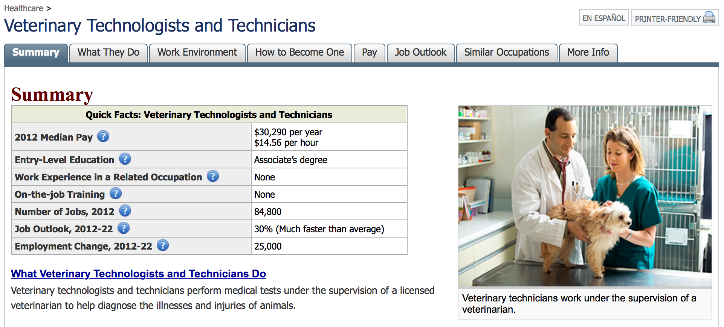
Source: Bureau of Labor Standards (2012)
http://www.bls.gov/ooh/healthcare/veterinary-technologists-and-technicians.htm

Slide 11
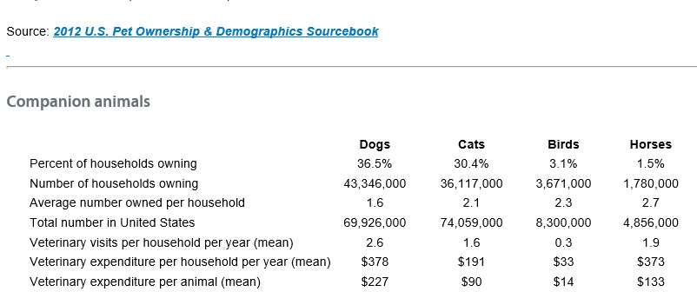
Pet Ownership

Slide 12
Veterinary Technology Education
2, 3, and 4-year programs
Accreditation by Committee on Veterinary Technician Education and Activities (CVTEA)
Must meet 11 criteria for curriculum, faculty, facility, and admissions
Includes essential & recommended tasks
2014 - 221 accredited programs
Distance Learning
2014 - 9 online programs
CE - 10 hours/year in Texas (can include 5 online) http://www.veterinary.texas.gov/
Notes:
Distance Learning:
Rigorous
Self-discipline
Flexibility
Preceptor
Videotapes, projects

Slide 13
Veterinary Technician National Exam
Requirements:
Graduate of accredited veterinary technician program
Within 6 months of graduation
Governed by American Association of Veterinary State Boards (AAVSB)
Exam is computer-based and 150 questions
Candidates get 3 hours to complete
Score is immediately known
For more information: https://www.aavsb.org/VTNE/
Notes:
20 pilot questions
2014: $300 exam fee
If fails:
Wait 91 days
3 times a year max
Can take 5 times without special considerations
4 1-month exam windows

Slide 14
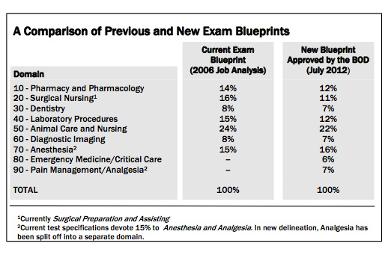
VTNE Exam Blueprint

Slide 15
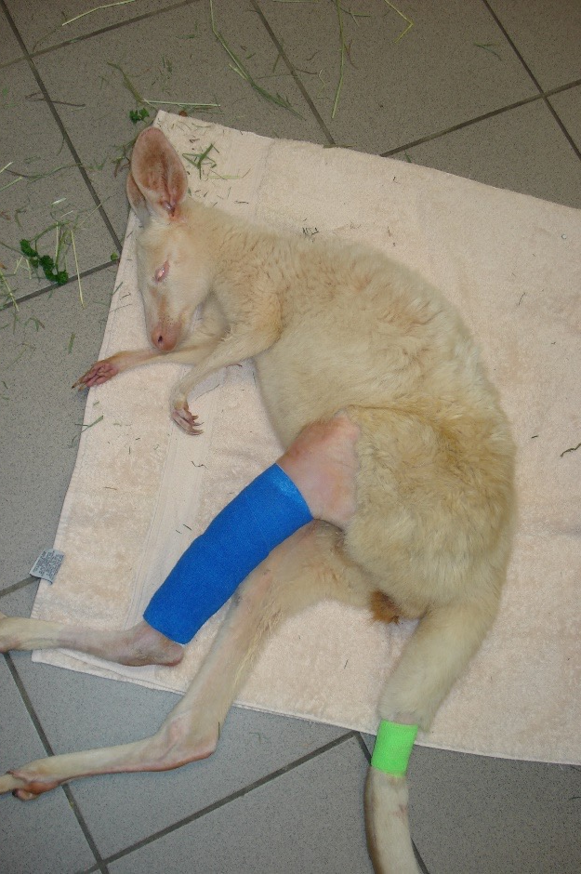
Veterinary Technician Specialties
Internal Medicine
Behavior
Clinical Pathology, Laboratory
Dentistry
Emergency/Critical Care
Nutrition
Surgery
Anesthesia
General Practice
Zoo medicine

Slide 16
Specialty Requirements
Veterinary Technology Degree
Experience in the field post-school
Membership in professional organizations
CE’s
Letters of Recommendation
Case Log
Case write-ups
Pass test
Notes:
10 hrs CE

Slide 17
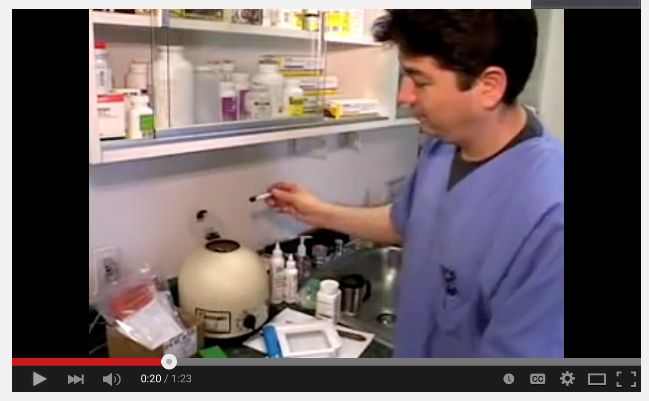
Video: A Day in the Life of a Vet Tech
https://www.youtube.com/watch?v=8WiZWRidxj4

Slide 18
Veterinary Technician Responsibilities
Reception
Exam rooms & outpatient visits
Laboratory & pharmacy
Radiology & special imaging
Treatment rooms
Wards
Hospital management
Notes:
Mention kennel workers

Slide 19
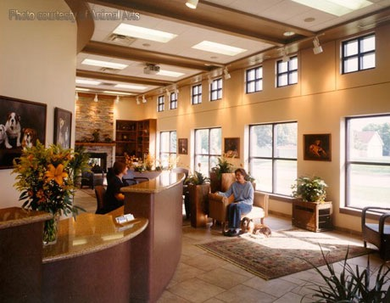
Reception
An essential function
Cross-training
Computer systems & practice management software
Client relations
Initial triage
High stress & attrition

Slide 20
Exam Rooms/Outpatient Care
Staying organized
Managing doctor’s attention
Careful of soundproofing
Histories and initial assessment
Specimen collection
Vaccinations
Client education & communication
Documentation

Slide 21
Laboratory/Pharmacy
In-house labs
Testing
Machine calibration & trouble-shooting
Outside lab coordination
Sample submission
Client communication
Filling scrips accurately

Slide 22
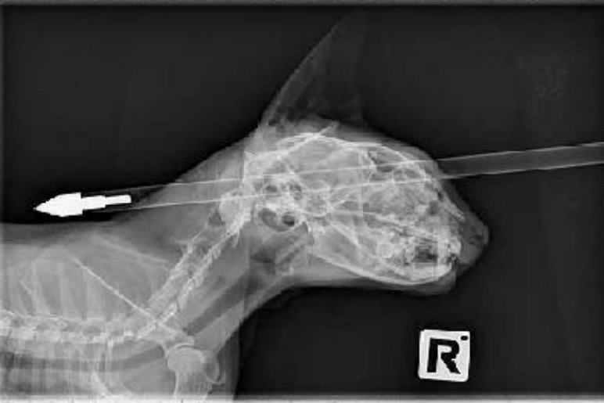
Radiology & Special Imaging
Digital vs film-based
Patient positioning
Exposure factors & trouble-shooting
Film developing
Special imaging:
Computed tomography (CT)
Magnetic Resonance Imaging (MRI)
Ultrasound
Endoscopy

Slide 23
Treatment Area
Usually central with a bank of cages
The “heart” of the hospital
Dentals & minor procedures
Medication administration
IV catheter placement & fluids
Blood draws & sampling
Bandages & wounds
Charting

Slide 24
Operating Room
Patient prep & scrub
Pre-meds & anesthesia
OR prep & clean-up
Scrubbing in
Anesthesia maintenance
Pack wrapping & sterilization
Recovery & patient transfer
Meds & orders

Slide 25
ICU & Patient Ward
Treatments & monitoring
Nutritional therapy
DVM alerts
TLC
IV fluids, catheters
Sample collection
Transfusions
Physical therapy
Pain management

Slide 26
Office & Hospital Management
Medical supplies
Inventory control
Bookkeeping
Practice management
Staff supervision
Training
Conflict resolution (!)

Slide 27
Things a Technician CAN’T do…
Surgery/Invasive dental
Diagnose
Prescribe
Initiate treatment (unless emergency)

Slide 28
What’s in a name?
Veterinarian - DVM
4 years graduate & 4 years undergraduate
Tested & licensed
Can be “board certified”
Veterinarian Technician Specialist (VTS)
Signified with a VTS after the name
Veterinary Technologist
Holds a 4-year degree in Veterinary Technology
Often holds positions of leadership

Slide 29
What’s in a name?
Licensed Veterinary Technician (LVT)
2-year degree in Veterinary Technology
State & nationally licensed
RVT vs LVT
Veterinary Assistant
Animal caregiver not in another category
Assist techs and DVM’s
Equivalent to a human Nurse’s Aide
Can be CVA
Laboratory Animal technicians & technologists
No degree requirement
Training & 3 levels of exams

Slide 30
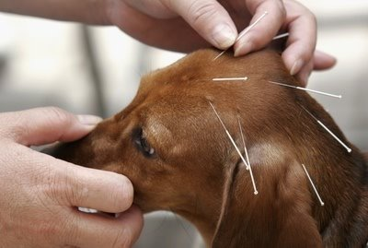
Trends in Veterinary Technology
Specialties
Alternative medicine – massage, acupuncture, chiropractic
Large animal procedures
Pet hospice care
Relief vet tech services
Pet insurance-related coordination

Slide 31
Important Organizations
National Association of Veterinary Technicians in America (NAVTA) -
Primary professional association
Committee on Veterinary Technician Education and Activities (CVTEA) - Accredits veterinary technician programs
American Association of Veterinary State Boards (AAVSB) – administers the VTNE
American Animal Hospital Association (AAHA) – accredits veterinary hospitals
Texas Board of Veterinary Medical Examiners (TBVME) – issues and renews Texas licenses to Veterinary Technicians.
Notes:
NAVTA: The National Association of Veterinary Technicians in America (NAVTA) was formed with the goal of allowing veterinary technicians to give input on national issues involving the veterinary profession.
NAVTA's goals for our members are:
To influence the future of each member's profession
To be a part of the decision-making process that affects our members
To foster high standards of veterinary care
To promote the veterinary health care profession

Slide 32
Supervision
Immediate- DVM who is within audible and visual range of patient and technician.
Direct- DVM who is physically present on the premises.
General- DVM who is readily available to communicate.

